Slide 1



“Online Book Store”

Slide 2

Online Book Store

Slide 3
CONTENTS
What is Online Book Store
Objectives
Requirements
Operations
Screen Shots
Data structure Screen Shots
Advantages
Conclusion

Slide 4
What is Online Book store?
Online Book Store is an online application Where the customer can purchase books Online. Through a web browser the customer can browse wide range of books from books, later can add to the shopping cart and finally Order to their address.
This application admin can perform CRUD operations like Adding , Deleting , Updating books

Slide 5
Objective
The Main objective of “Online Book Store “ is to provide an essence of online book store via a simple and yet powerful medium.
The project has been designed to stimulate the working of an actual online book store.
This Project provide simple UI for user so that user can easily access web site .

Slide 6
Requirements
Hardware requirement
1) 8 GB of RAM
2) I5 core Processor
Software requirement
1) Microsoft Visual Studio 2019
2) SQL Server
3) Wamp Server
Operating System
1) Windows 10

Slide 7
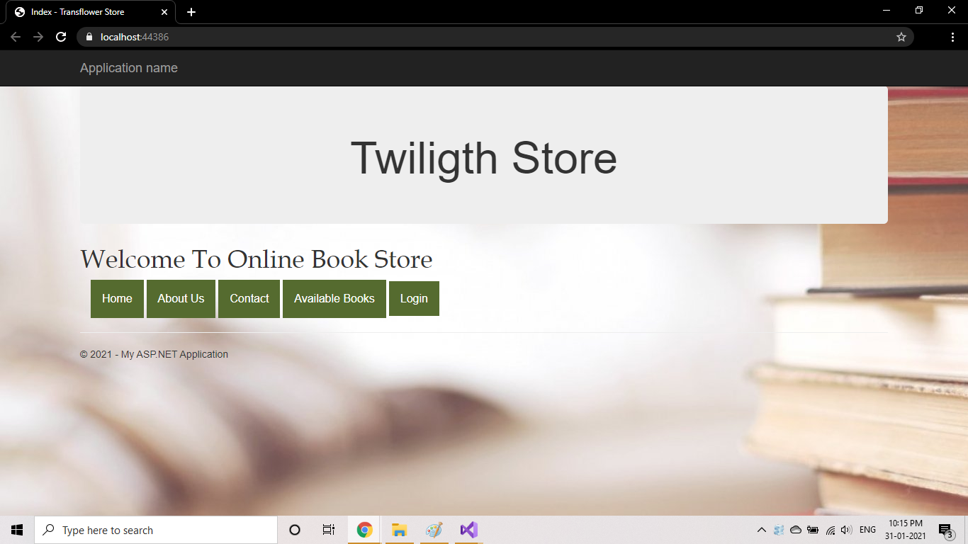
Screen Shot :- 1 Home Page

Slide 8
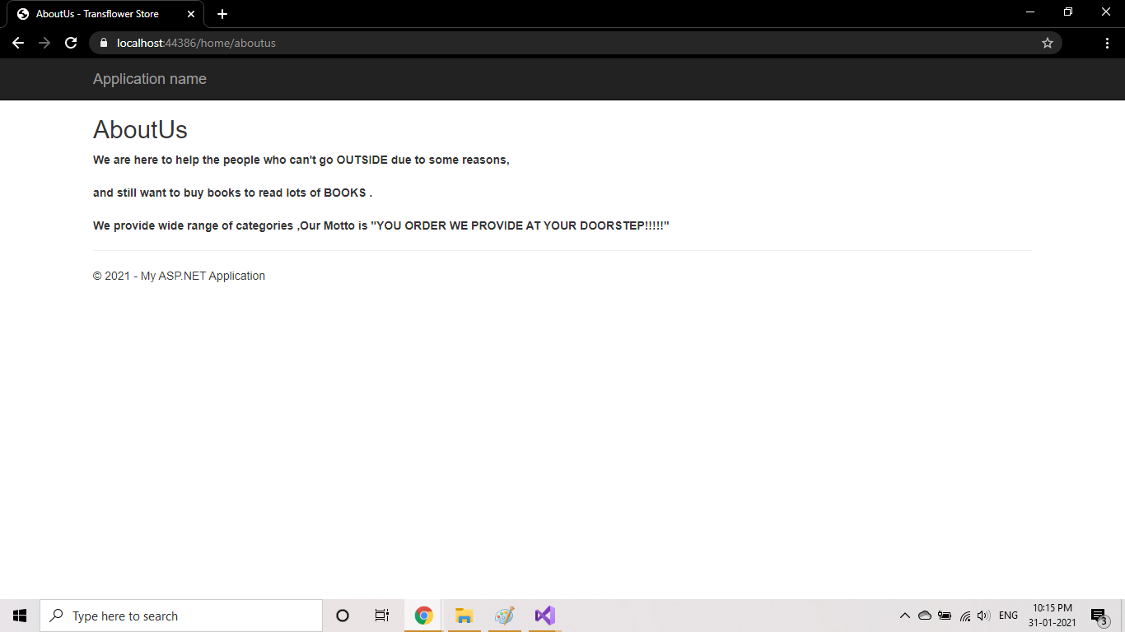
Screen Shot :-2 About Us

Slide 9
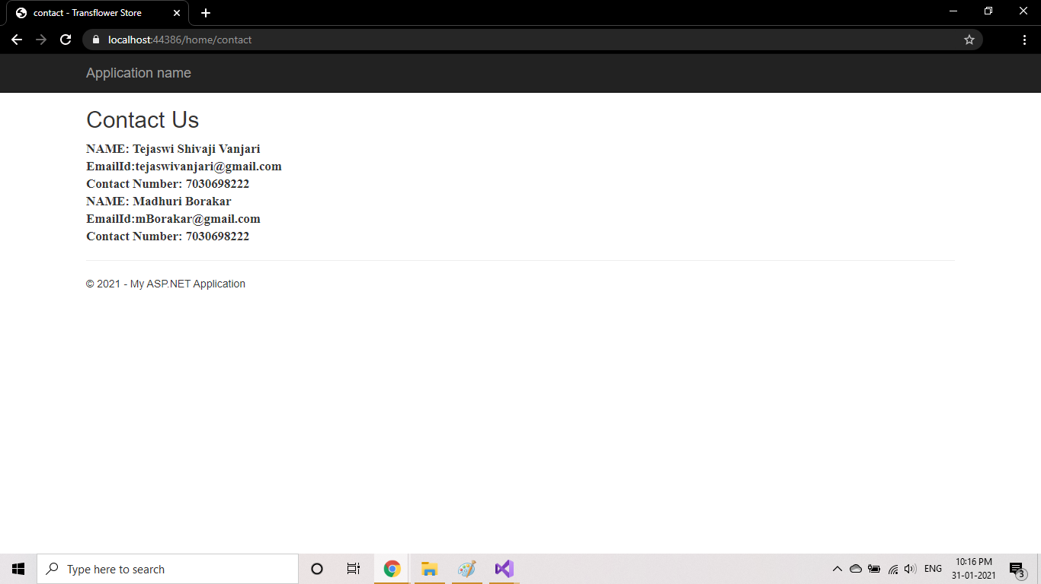
Screen Shot :-3 Contact Us

Slide 10
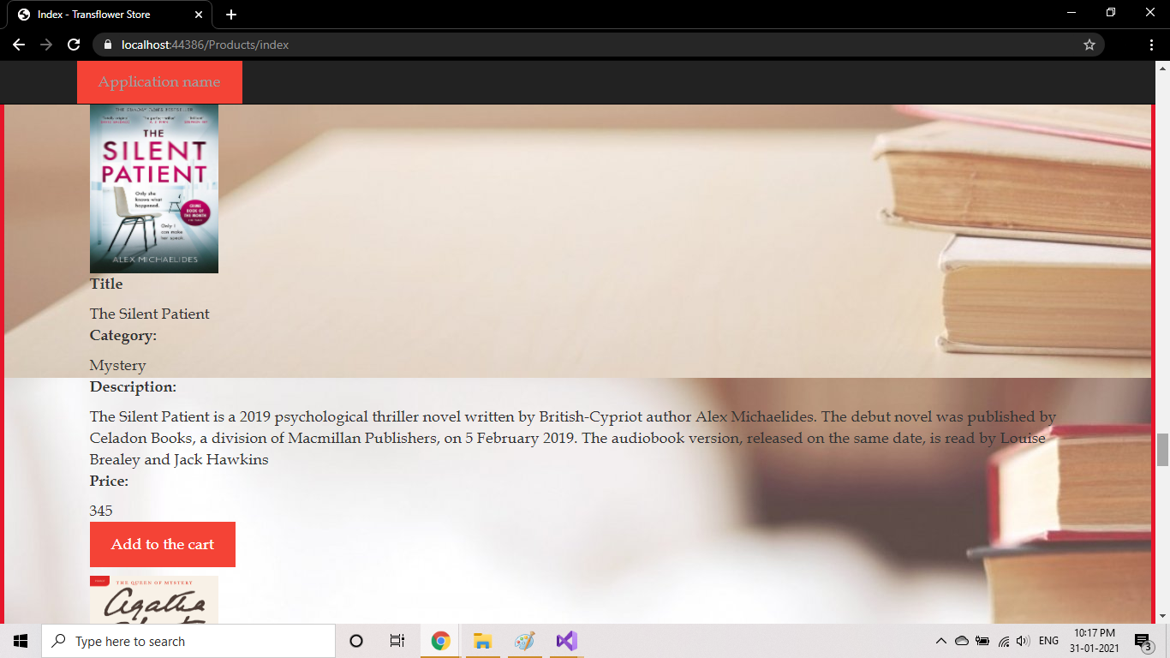
Screen shot :- 4 Books

Slide 11
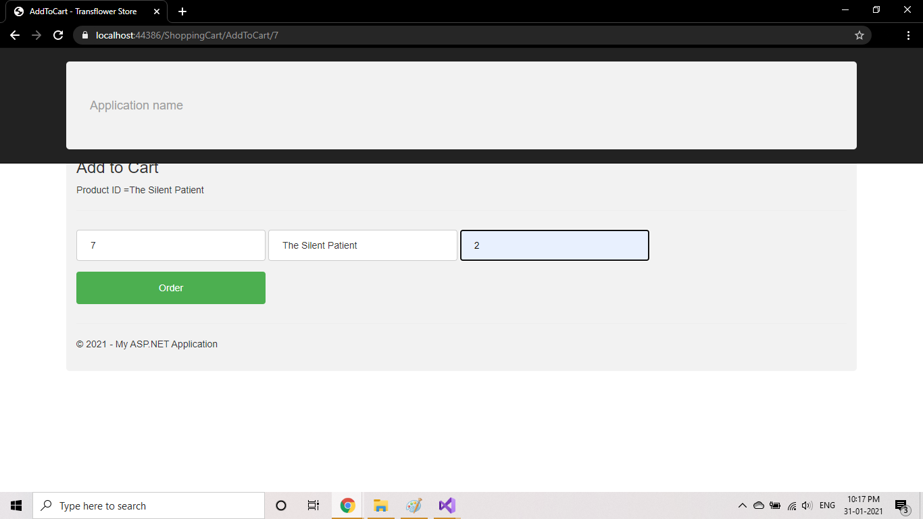
Screen Shot :- 5 Add to Cart

Slide 12
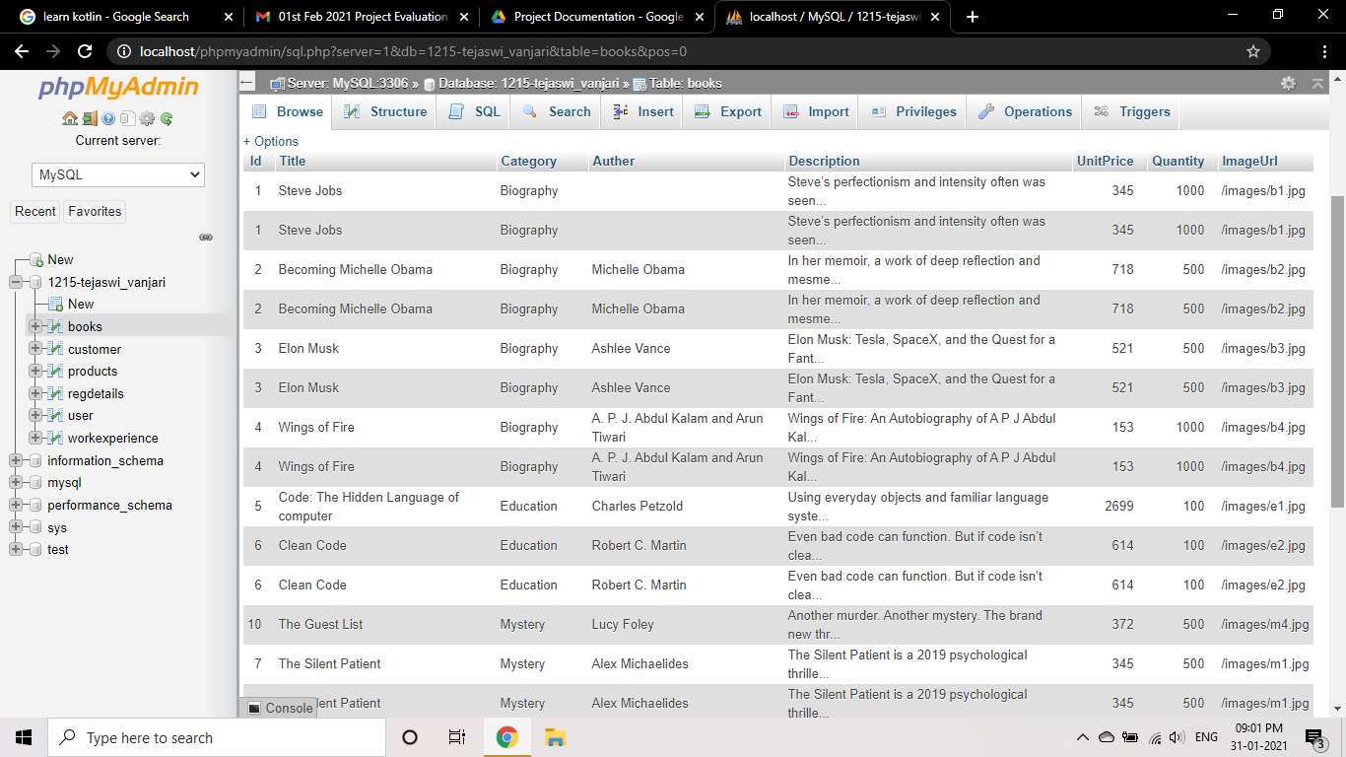
Screen Shots :- 6 Data structure

Slide 13
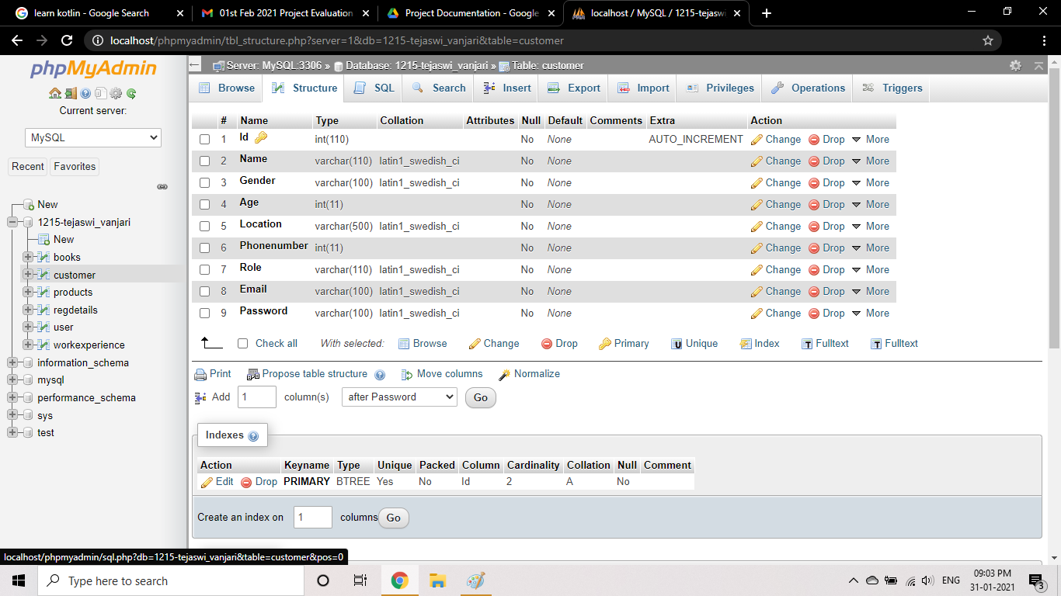
Screen Shots :- 7 Data structure

Slide 14
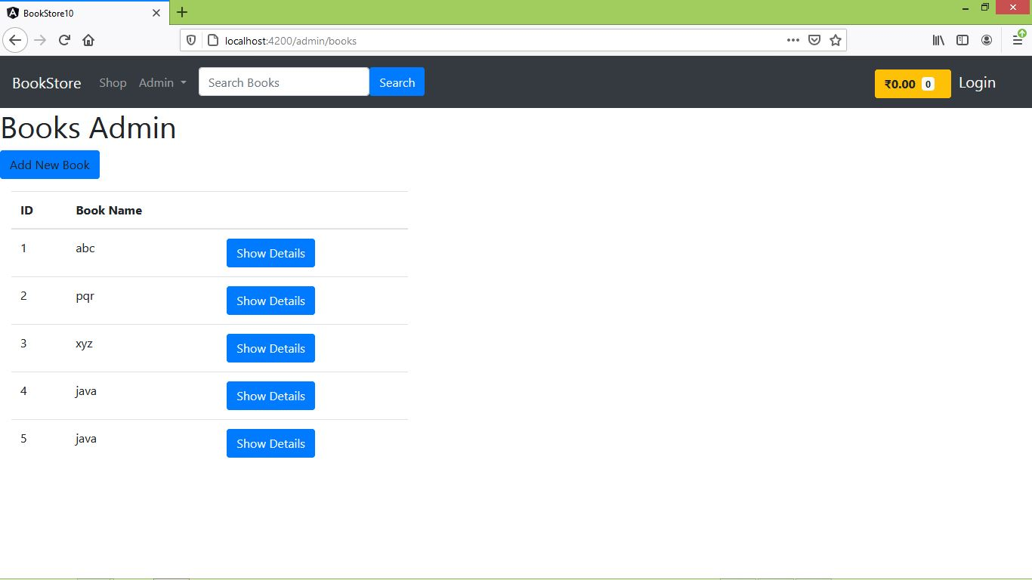
Spring Boot + Angular Project

Slide 15
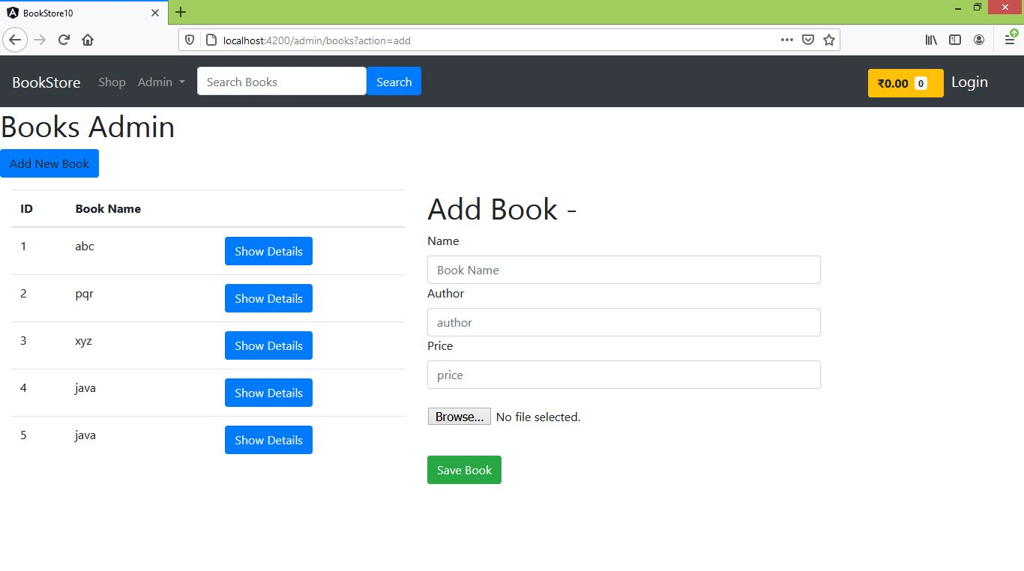
Screen Shot :- 8

Slide 16
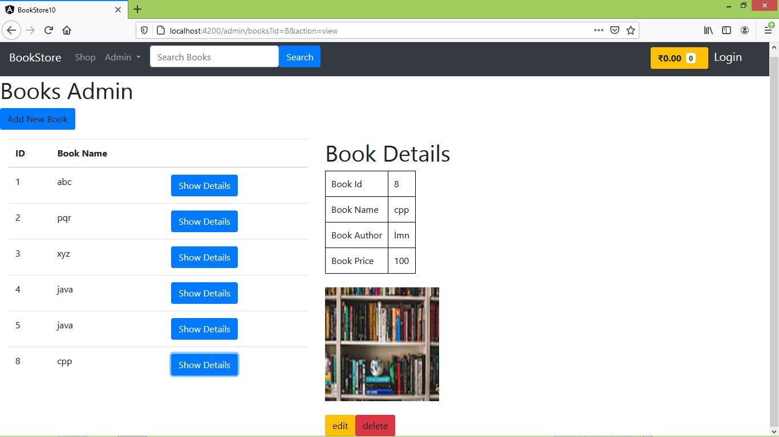
Admin Part

Slide 17
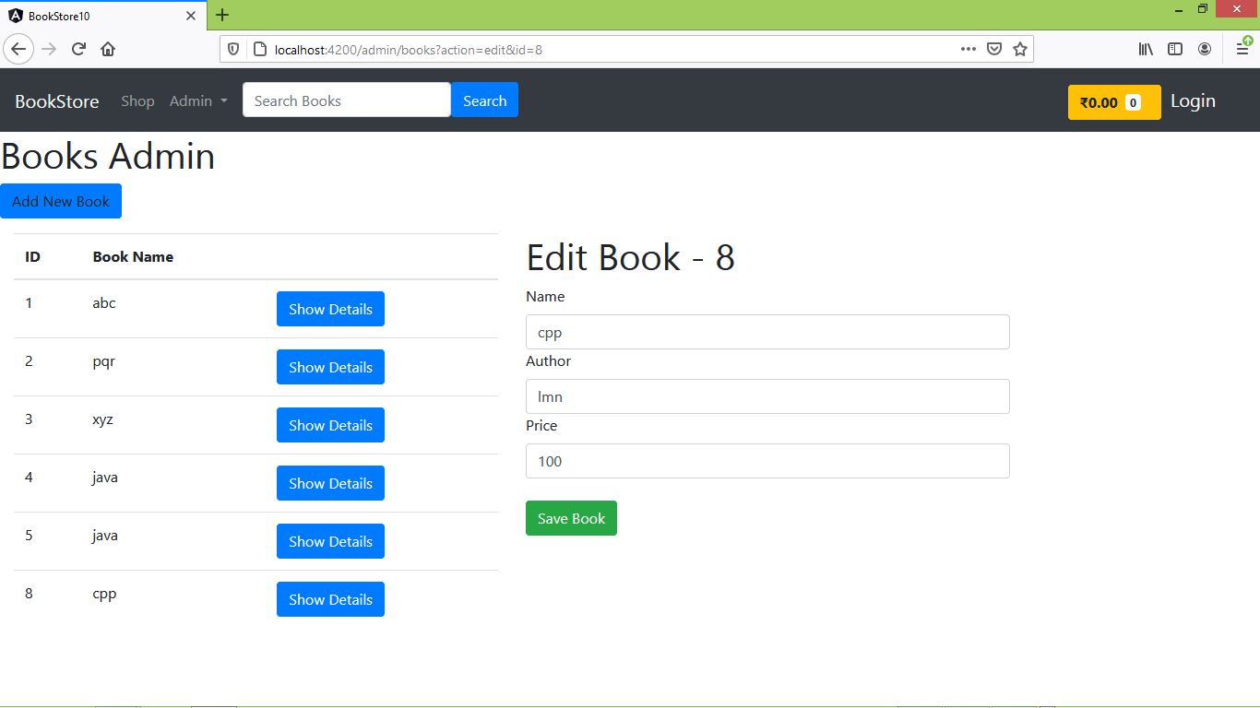
Admin Part :-2

Slide 18
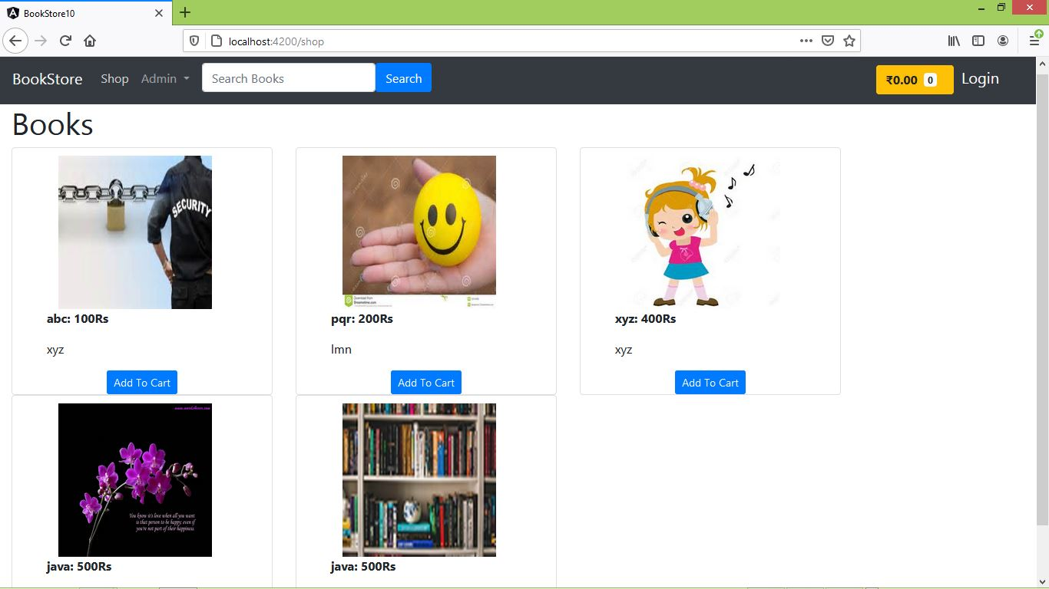

Slide 19
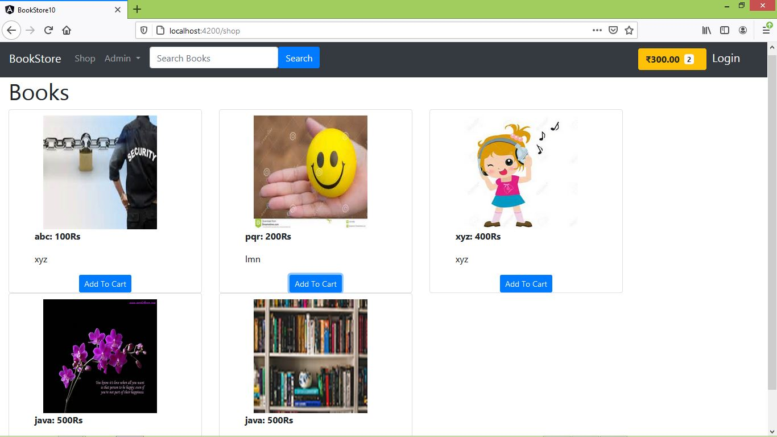
Home Page

Slide 20
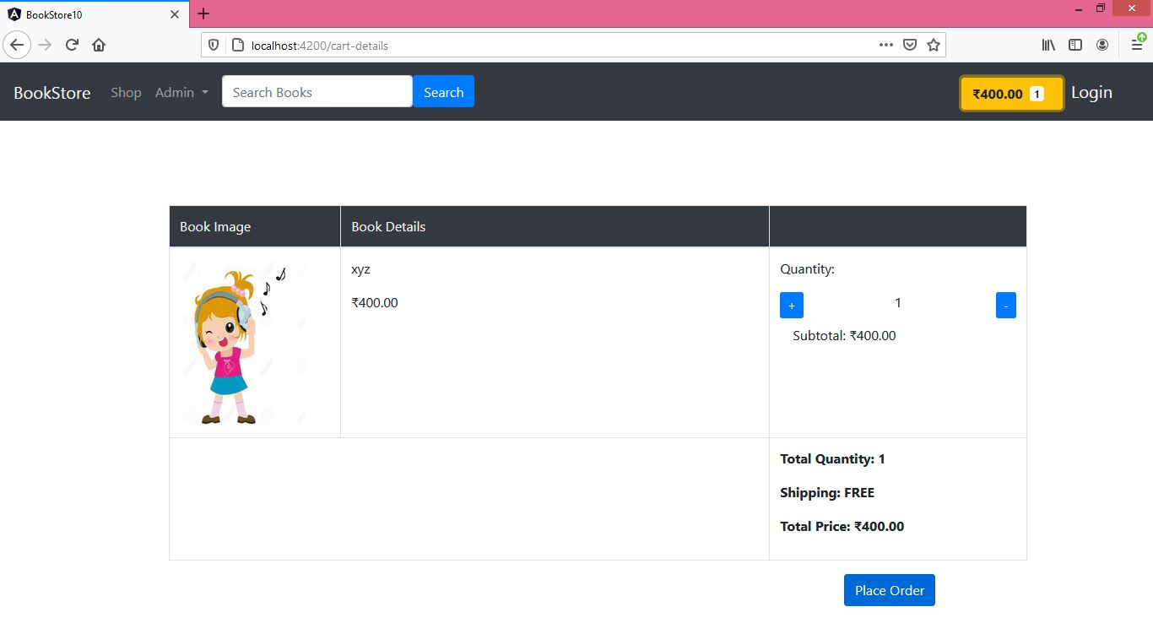
Book Details

Slide 21
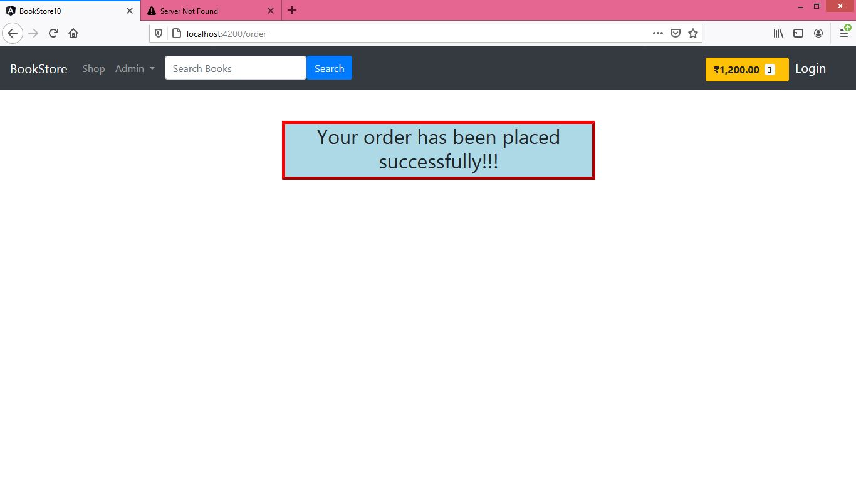
Screen Shot Placed Order

Slide 22
Advantages
Cost Saving
Time saving
Fast purchasing
View books of all categories
Home Delivery

Slide 23
Future Scope
This project can be enhanced further by adding online payment facility for the order payment. The software is flexible enough to be modified and implemented as per future requirements. We have tried our best to present this free and user–friendly website to college students and faculty. Email alerts for various happenings in the college can be added to the system so that users do not miss the updates and happenings of the process.

Slide 24
Conclusion
The system work on internet server, so it will be operated by any end user for the buying purpose with secure platform.
This system protects the integrity of the farmers and customers, provides easy returns, buying policies and offers.

Slide 25


